Slide 1
THE BATTLE of Neighborhoods ABC COMPANY LIMITED

Slide 2
introduction
New York city review for ABC
Company.
• Optimum location for new
Restaurant business
• Business Problem :
- Choice of first neighborhood to
start restaurant business.
- Easy to replicate.
- High demand
- Choice of Menu
• Success Criteria :

Slide 3
• Most crowded city in the United States
• It is assorted and is the budgetary capital of
USA
• Provides part of business openings
• Attracted a wide range of players into the
advertise
• Global center point of business and trade.
• The city is a significant community for banking and
account, retailing, world exchange,
transportation, the travel industry, land, new
legitimate administrations, bookkeeping, protection,
theater, design, and expressions of the human experience in the
US.

Slide 4
cuisine
The City of New York is acclaimed for its amazing cooking. It's nourishment culture incorporates
a variety of universal cooking styles impacted by the city's worker history.
• Central and Eastern European foreigners, particularly Jewish settlers -
bagels, cheesecake, wieners, knishes, and shops
• Italian foreigners - New York-style pizza and Italian cooking
• Jewish foreigners and Irish settlers - pastrami and corned meat
• Chinese and other Asian eateries, sandwich joints, trattorias, cafes, and
cafés are pervasive all through the city
• Mobile nourishment merchants - Some 4,000 authorized by the city
• Middle Eastern nourishments, for example, falafel and kebabs instances of current New
York road nourishment
• Famous for top notch food Michelin featured eateries. The city is home to
"almost one thousand of the best and most various haute cooking eateries
on the planet", as indicated by Michelin.
• So it is apparent that to make due in such serious market it is significant
to deliberately design.

Slide 5
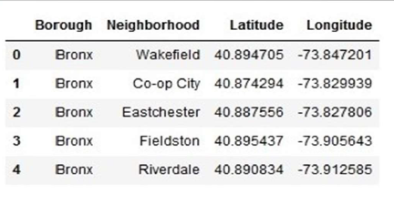
DATA DESCRIPTION -1
Data 1 : Neighborhood has a total of 5 boroughs and 306 neighborhoods. In
order to segment the neighborhoods and explore them, we will essentially
need a dataset that contains the 5 boroughs and the neighborhoods that
exist in each borough as well as the latitude and longitude coordinates of
each neighborhood.
• This dataset exists for free on the web. Link to the dataset is :
https://geo.nyu.edu/catalog/nyu_2451_34572

Slide 6
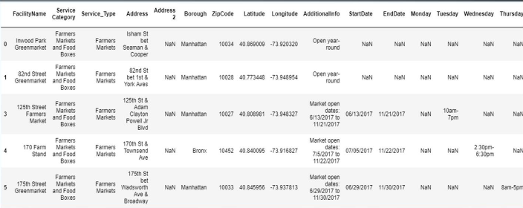
DATA DESCRIPTION-2
• Data 2 : Farmers Markets data -
• https://data.cityofnewyork.us/dataset/DOHMH-Farmers-Markets-and-
Food-Boxes/8vwk-6iz2
• A farmers' market is often defined as a public site used by two or more local
or regional producers for the direct sale of farm products to consumers. In
addition to fresh fruits and vegetables, markets may sell dairy products, fish,
meat, baked goods, and other minimally processed foods.

Slide 7
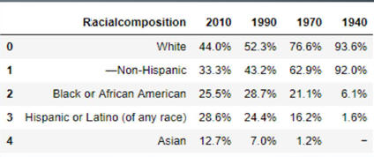
DATA DESCRIPTION-3
Data 3 : Data from Wikipedia pages as given below :
• New York Population
• New York City Demographics
• Cuisine of New York city
https://en.wikipedia.org/wiki/New_York_City
https://en.wikipedia.org/wiki/Economy_of_New_York_City
https://en.wikipedia.org/wiki/Portal:New_York_City
https://en.wikipedia.org/wiki/Cuisine_of_New_York_City

Slide 8
ANALYTICAL APPROACH
• New York city neighborhood has an aggregate of 5 wards and
306 neighborhoods
• PART 1 - Clustering of Manhattan and Brooklyn
• PART 2 - Clustering of Bronx, Queens and Staten Island.
• Only RESTURANT information is sifted from foursquare.com settings
information and used for this venture.
• This is done due to the accompanying Exploratory information investigation

Slide 9
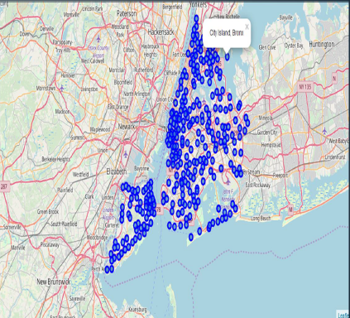
METHODOLOGY-1
data 1-New york city
Topographical Coordinates Data.
• Load the information and investigate
information - newyork_data.jso
• Transform the information of settled
python lexicons into a
pandas dataframe.
• Dataframe contains the topographical directions
• Data will used to get Venues information from Foursquare
.• Geopy and folium libraries utilized to make a guide of New York city with superimposed on top.

Slide 10
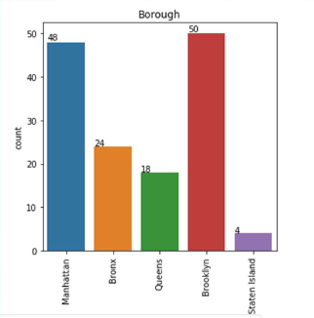
Methodology-2
Data 2- DOHMH Farmers
• In this we will be using the data of Farmers Markets
• There are totally 144 Farmers Markets in New York city
• Highest number are in Manhattan and Brooklyn.And lowest in Queens, Bronx and Staten Island
.

Slide 11
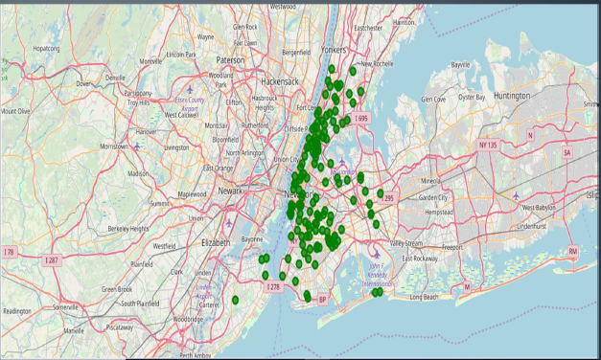
FARMER market visualization

Slide 12
METHODOLOGY-3
Data 3 : To analyize New York city Population, Demographics
also, Cuisine , rejected the information from Wikipedia pages given
above in the information segment.
• We utilized BeautifulSoup python library.
• Beautiful Soup is a Python bundle for parsing HTML and XML
records (counting having twisted markup, for example non-shut
labels, so named after label soup).
• It makes a parse tree for parsed pages that can be utilized to
extricate information from HTML, which is valuable for web scratching

Slide 13
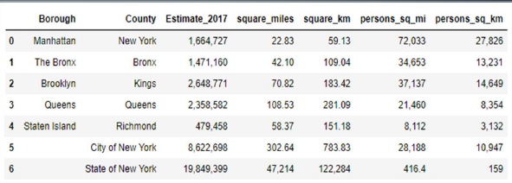
NEW YORK CITY-POPULATION

Slide 14
Methodology-3-Cuisine of new york city
• This data has been manually prepared. Data is taken from Wikipedia page- https://en.wikipedia.org/wiki/Cuisine_of_New_York_City
• Data used to create word cloud.
NEW YORK CITY CUISINE : Most Preferred Food in New York City –Italian,Purto Rican, Mexican, Jewish, Indian, Pakistani & Dominican
QUEENS CUISINE – Most Preferred Food in Queens is– Indian, Irish, Pakistani and Mexican.
• THE BRONX CUISINE – Most Preferred Food in The Bronx is – Italian, Puerto Rican,Albanian and Dominican.

Slide 15
METHODOLOGY-4
NewYork city geological directions information has be used as contribution for the Foursquare API, that has been utilized to arrangement settings data for every area.
• We utilized the Foursquare API information to investigate neighborhoods in
New York City.
• Using the land directions of every area foursquare API calls are made to get top 200 settings in a sweep of 1000 meters
PART – 1 Brooklyn and Manhattan
PART – 2 Bronx, Queens and Staten Island

Slide 16
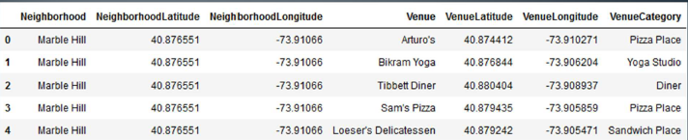
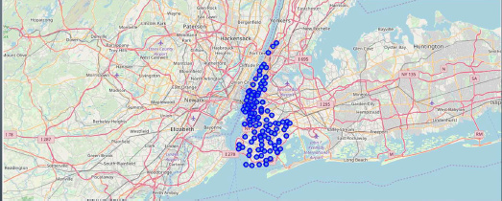
Brooklyn and Manhattan Venues data

Slide 17
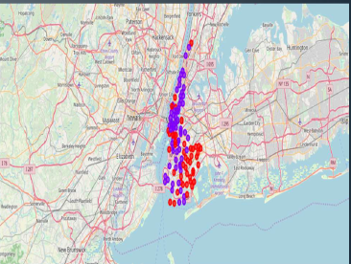
RESULTS PART-1 Brooklyn and manhattan
• Segmenting and Clustering Neighborhoods- Cluster0 : The Total and Total Sum of cluster0 has smallest value. It shows that the market is not saturated.
- Cluster1 : The Total and Total Sum is very high. Lot of competition. Saturated neighborhoods

Slide 18
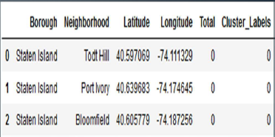
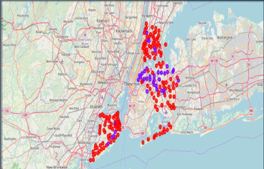
Part 2-BRONX,QUEENS AND STATEN ISLAND
Segmenting and Clustering Neighborhoods
- Cluster0 : The Total and Total Sum of cluster0 has smallest value. It shows that the market is not saturated.There are untapped markets.
- Cluster1 : The Total and TotalSum is very high. Lot of competition. Saturated neighborhoods.

Slide 19
DISCUSSION
Extension to investigate cooking styles of different nations in Bronx, Queens and
Staten Island
• In Manhattan and Brooklyn eateries , cooking styles of numerous nations are a piece of their Menu. Hazard can be taken with incredible menu ready. It additionally shows individuals love what's more, investigate cooking styles of different nations.
Investigation performed on restricted information
• Re-run program with refreshed data
• Brooklyn and Manhattan has high convergence of café business. Very serious market.
• Bronx, Queens and Staten Island too has great number of eateries however not the same number of as required. So this can be investigated.
• according to the area or eatery type referenced like Indian Restaurant, examination can be checked. A setting with most minimal hazard and rivalry can be distinguished

